Slide 1
EMC Test and Measurement Environments
Open Area Test Site
Screened Room
Anechoic Chamber
TEM/GTEM Cell
Reverberation Chamber
Reference book:
Levent Sevgi, ‘’A Practical Guide to EMC Engineering’’, 2017 ARTECH HOUSE

Slide 2
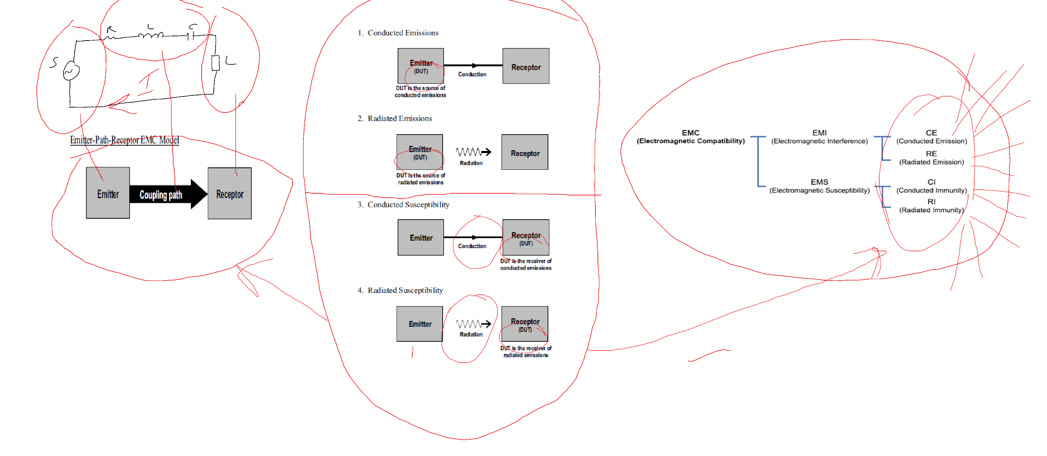
Big picture
Open Area Test Site
Screened Room
Anechoic Chamber
TEM/GTEM Cell
Reverberation Chamber

Slide 3
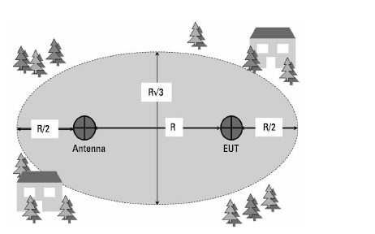
1. Open Area Test Site

Slide 4
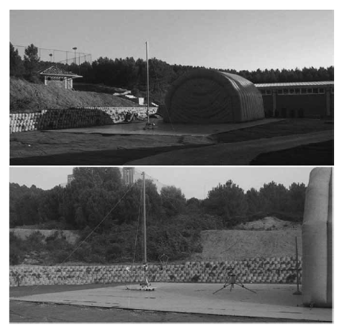
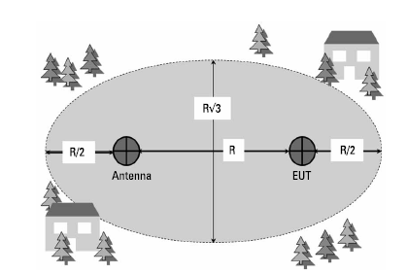
1. Open Area Test Site Open Area Test Site Calibration

Slide 5
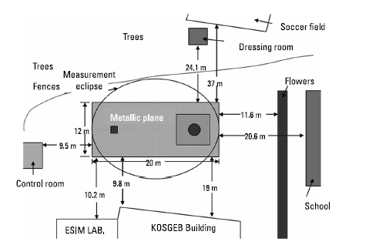
1. Open Area Test Site Open Area Test Site Calibration
The critical parameter in OATS calibration is Normalized Site Attenuation (NSA).

Slide 6
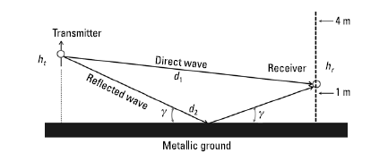
1. Open Area Test Site Open Area Test Site Calibration
Normalized Site Attenuation (NSA).

Slide 7
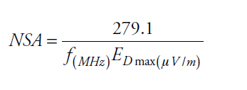
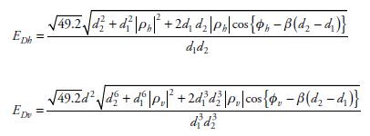
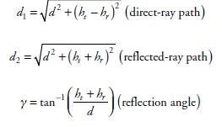
1. Open Area Test Site Open Area Test Site Calibration
Normalized Site Attenuation (NSA).

Slide 8

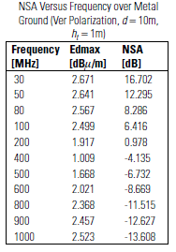

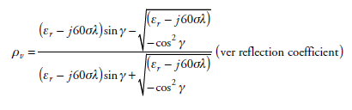
Normalized Site Attenuation (NSA).

Slide 9
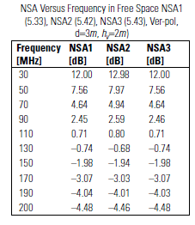


Normalized Site Attenuation (NSA).

Slide 10
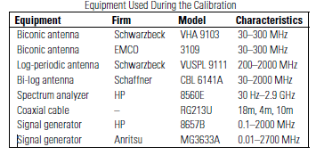
1. Open Area Test Site Open Area Test Site Calibration
Notes:
Ferromanyetik

Slide 11
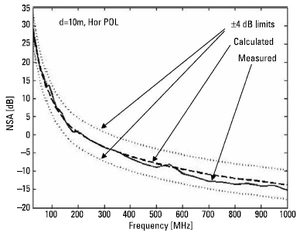
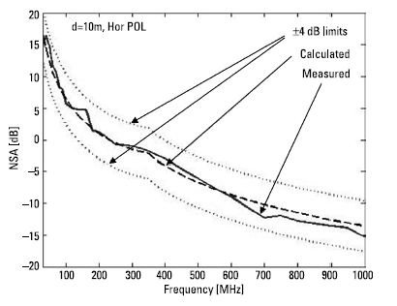
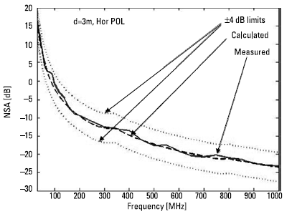
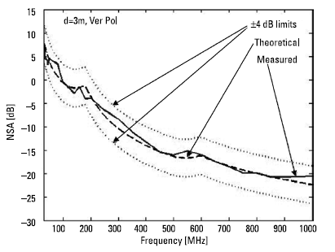
1. Open Area Test Site Open Area Test Site Calibration

Slide 12
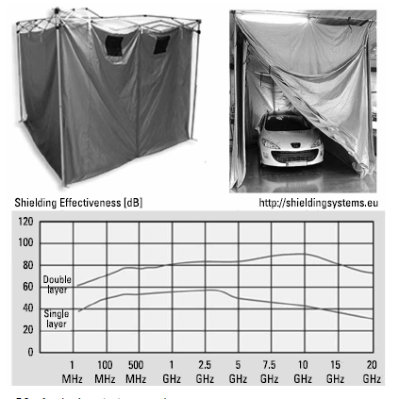
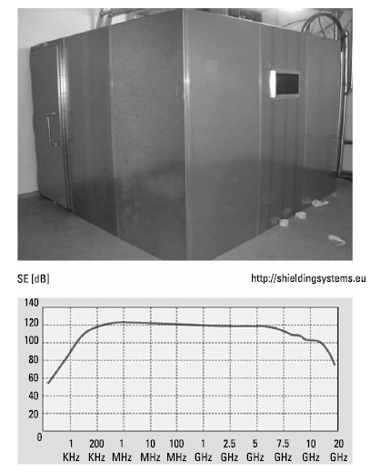
EMC Test and Measurement Environments
2. Screened Room
40–60 dB screening is assumed average
80–100 dB isolation is good
Notes:
Ferromanyetik malzemeden yapılır.

Slide 13
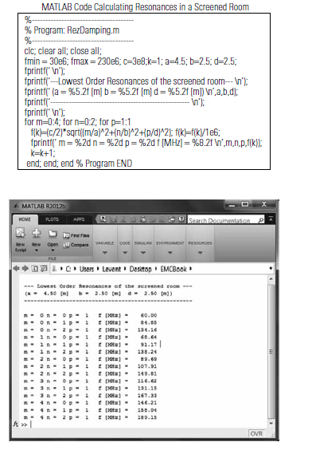

EMC Test and Measurement Environments
2. Screened Room and Resonance Effects

Slide 14
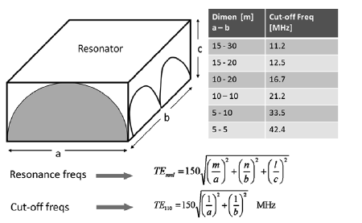
EMC Test and Measurement Environments
2. Screened Room and Resonance Effects

Slide 15
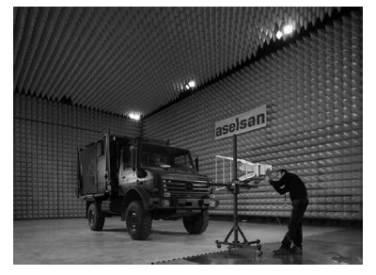
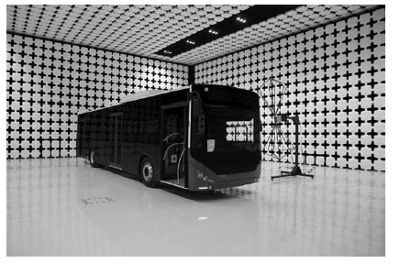
EMC Test and Measurement Environments
3. Anechoic Chamber
Notes:
RE ve RI testleri Açık alan test sahasında veya yansımasız odada gerçekleştirilir.
Büyük firmalar(askeri ve sivil) kendi yansımasız odaları mevcuttur.

Slide 16
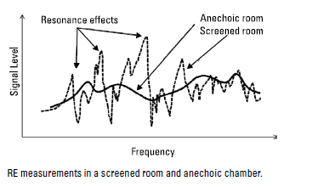
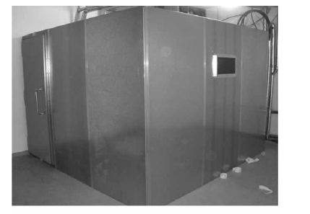
EMC Test and Measurement Environments
3. Anechoic Chamber
Notes:
Ekranlı odaların sonsuz sayıda rezonans frekansı vardır.Bu rezonans frekanslarında oda içinde bulunan elektromanyetik işaretler 20-40 dB (binlerce kez ) kuvvetlendirilir. Bu nedenle , ekranlı oda içinde belgelendirme amaçlı EMC emisyon ölçüleri yapılamaz.

Slide 17
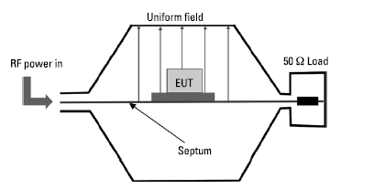
EMC Test and Measurement Environments
4. TEM /GTEM Cell

Slide 18
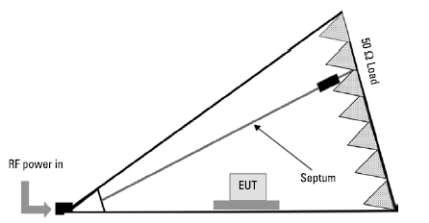
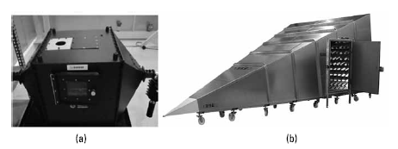
EMC Test and Measurement Environments
4. TEM /GTEM Cell

Slide 19
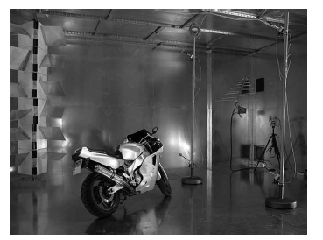
EMC Test and Measurement Environments
5. Reverberation Chamber
A reverberation chamber used in immunity tests.

